Slide 1
What is the perimeter of this shape?
What is the area of the shape?
What are the prime factors of 56?
A new computer is advertised as $300 and then discounted by 15%. What is the new price
Three friends measure their heights as 110cm, 127cm and 123cm. What is their average height?

Slide 2
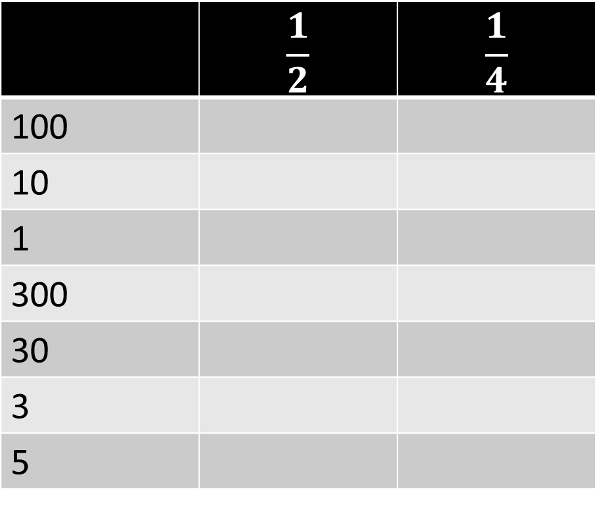
How do I make a decimal out of a fraction?
Using the halving technique….
Find half and a quarter of the following
Now try this….
 | $$\frac{1}{2}$$ | $$\frac{1}{4}$$
100
10
1
300
30
3
5
 | ÷2 | ÷4
100
10
1
300
30
3
5
What is the link between division and fractions?

Slide 3
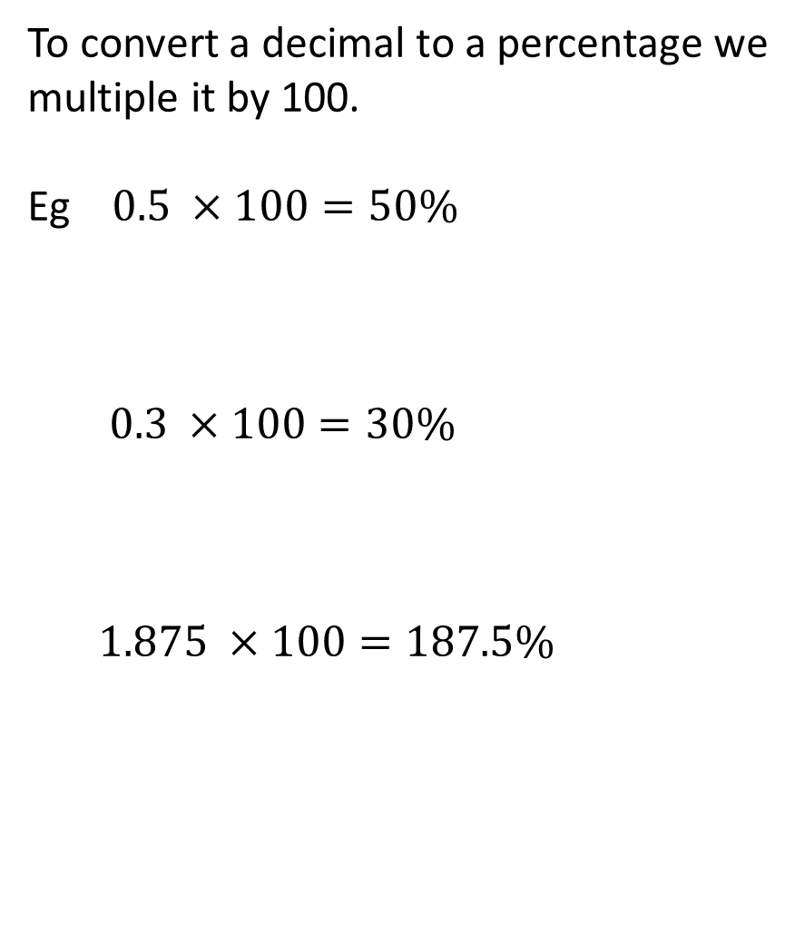
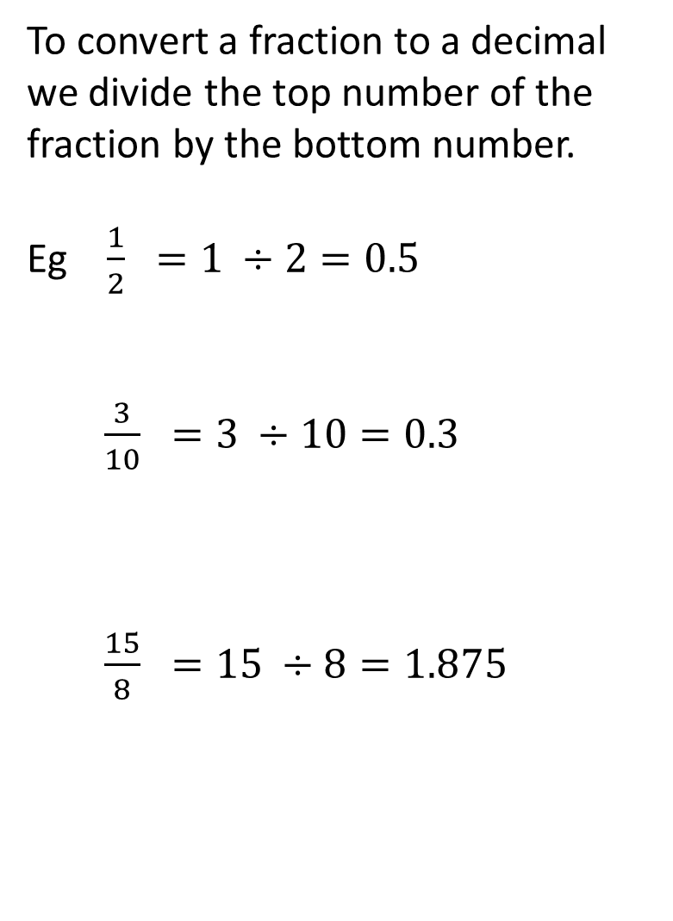
Topic: Fractions to decimals
EQ: How do we convert fractions to decimals and percentages?
To convert a fraction to a decimal we divide the top number of the fraction by the bottom number.
Eg $\frac{1}{2} =1 ÷2=0.5$
$\frac{3}{10} =3 ÷10=0.3$
$\frac{15}{8} =15 ÷8=1.875$
To convert a decimal to a percentage we multiple it by 100.
Eg $0.5 ×100=50\%$
$0.3 ×100=30\%$
$1.875 ×100=187.5\%$

Slide 4
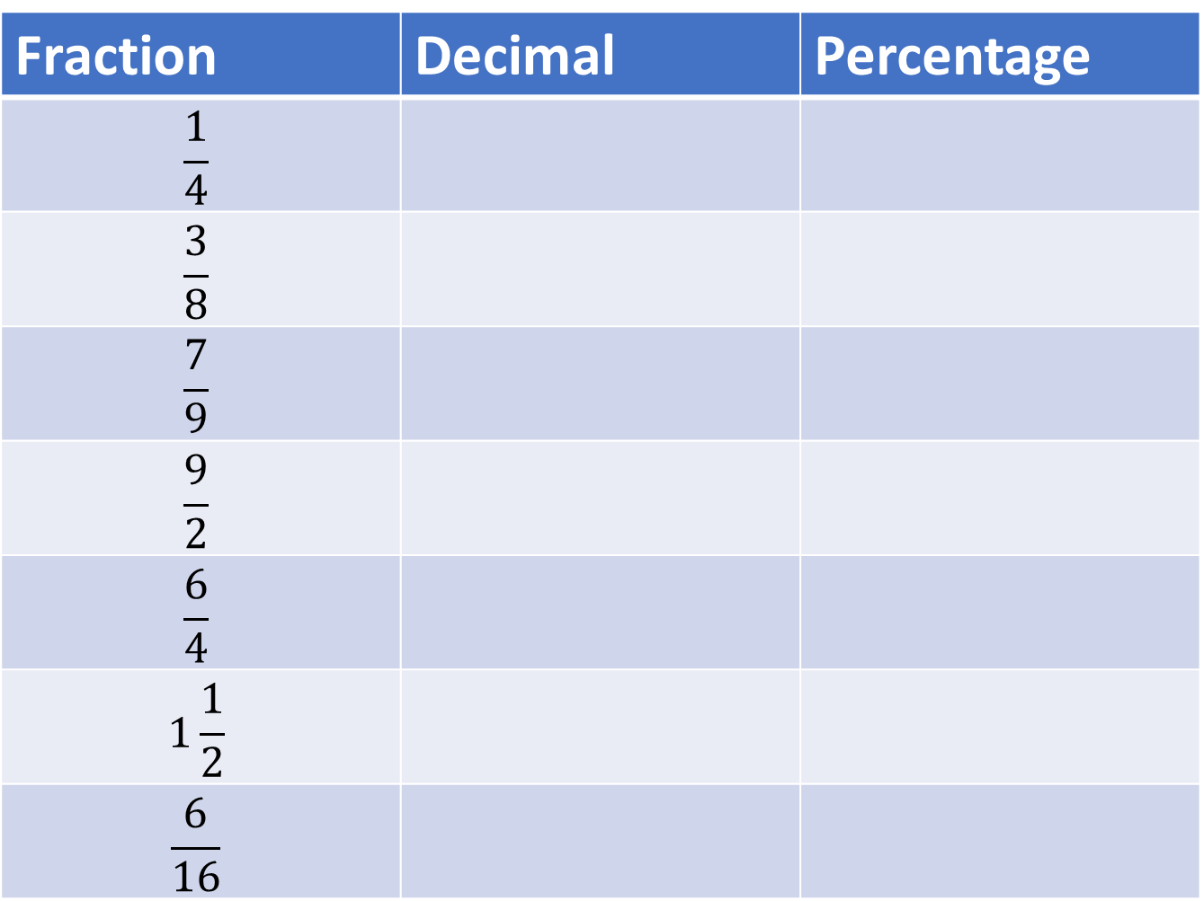
Fraction | Decimal | Percentage
$$\frac{1}{4}$$
$$\frac{3}{8}$$
$$\frac{7}{9}$$
$$\frac{9}{2}$$
$$\frac{6}{4}$$
$$1\frac{1}{2}$$
$$\frac{6}{16}$$

